Slide 1
Diffusion and Ion Implantation
Processes Involved in IC Manufacturing on the Wafer:
Diffusion/ion implantation
Photolithography
Deposition
Oxidation
Etching
Notes:
The wafer obtained after undergoing the processes discussed in the last lectures goes though another set of processes to manufacture IC finally on it. These steps include:
Diffusion and ion implantation: This is the step of introducing deliberately the dopants or impurities into either precise regions and/or complete wafer. Ion Implantation offers more precisely controlled dopant introduction.
Photolithography: This step is done to select the region for processes like diffusion, implantation, oxidation and etching. It uses a material called photoresist to select the processing regions.
Deposition: it is a step of depositing certain materials on the wafer. Eg. Deposition of metal for lead connection.
Oxidation: This process allows Si wafer to be oxidized in a controlled manner in a specially designed chamber to form SiO₂. this oxide behaves as an insulator on the wafer layer.
Etching: Etching is the process of chemically cleaning and removal of selected regions on the wafer.
In a few lectures from today we shall focus on the two mechanisms of introducing impurities or dopants into the wafer: DIFFUSION and ION-IMPLANTATION.

Slide 2
Impurity Doping
Two methods for introducing impurities into Si to control the majority-carrier type and resistivity of layers
  Diffusion: dopant atoms move from the surface into Si by thermal means via substitutional or interstitial diffusion mechanisms.
  Ion implantation: dopant atoms are forcefully added into Si in the form of energetic ion beam injection.
IC Technology Ms. Neha Singh
Notes:
Si wafers are doped with impurities to control the majority carrier type and their resistivities.
Diffusion is a process in which material atom moves in crystal lattice from regions of higher concentration into the regions of lower concentration to achieve equilibrium. The dopant atoms move from the surface into Si by thermal means via substitutional or interstitial diffusion mechanisms. Diffusion depends upon the concentration of vacancies available in the wafer.
Ion implantation is another method to introduce dopant atoms into Si wafer. The dopants are forcefully added into Si in the form of energetic ion beam injection. Though the process is more controlled as compared to diffusion but the striking of energetic atoms on the surface results into unwanted mechanical defects in the wafer for which the wafers need to be treated.

Slide 3
Need of doping
  Formation of pn junction and fabrication of devices during wafer fabrication.
  alter the type and level of conductivity of semiconductor materials.
  form bases, emitters, and resistors in bipolar devices, as well as drains and sources in MOS devices.
  dope polysilicon layers.
IC Technology Ms. Neha Singh

Slide 4
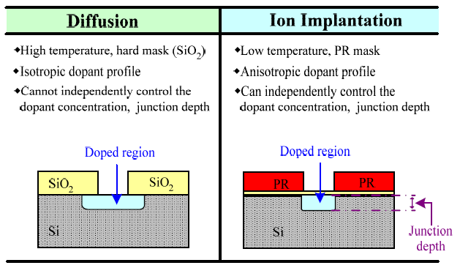
Comparison
IC Technology Ms. Neha Singh
Notes:
If the two processes of doping are compared the highlights are as follows:
Diffusion requires high temperature but ion implantation can be done at low temperatures.
At high temperatures, the crystal structure is disturbed and the dopants diffuse into Si by taking up the lattice sites which are made
vacancies by Si atoms which tend to move by taking up energy due to high temperature.
2. Diffusion requires hard mask like SiO₂ but ion implantation can be done with a soft mask of photoresist.
3. The dopant profile is isotropic for diffusion and anisotropic for ion implantation.
The dopants diffuse equally in all directions. So, as shown in this figure the dopants diffuse well under the SiO₂ layer. The dopant profile of diffusion is also shown in next slide. Where as for ion implantation high energy ions strike the surface through the opening in the mask and thus do not move sideways under the mask.
4. The dopant concentration and the junction depth cannot be controlled independently for diffusion mechanism.
By controlling the energy of the ions, the depth to which they move can be greatly controlled so it is for ion implantation method that
the dopant concentration and junction depth is controlled.

Slide 5
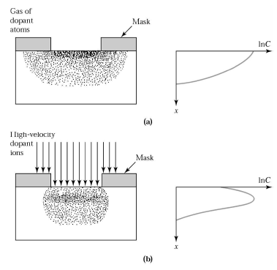
Doping Profiles
IC Technology Ms. Neha Singh
Notes:
Diffusion is isotropic process i.e. it allows dopants to move in all the directions uniformly. And thus, dopants well diffuse under SiO₂ as shown in figure (a) above.
Ion implantation is anisotropic in nature so, the dopants move vertically to the depth of the wafer.

Slide 6
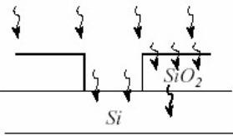
Diffusion
Diffusion: movement of a chemical species from an area of high concentration to an area of lower concentration.
The diffusion process begins with the deposition of a shallow high concentration of the desired impurity in the Si surface through windows etched in the protective barrier layer.
IC Technology Ms. Neha Singh
Notes:
Diffusion is the movement of a chemical species from an area of high concentration to an area of lower concentration. The controlled diffusion of dopants into silicon is the foundation of forming a pn junction and fabrication of devices during IC fabrication. Diffusion is used primarily to alter the type and level of conductivity of semiconductor materials. It is used to form bases, emitters, and resistors in bipolar devices, as well as drains and sources in MOS devices. It is also used to dope polysilicon layers.

Slide 7
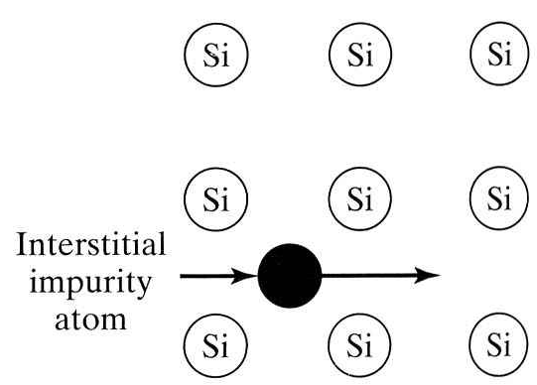
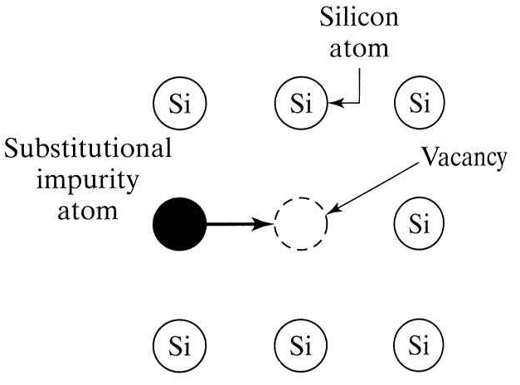
Diffusion mechanism (7 methods)
1. Interstitial diffusion (Na, Li)
- fast process.
- diffuses in interstitials.
- does not depend upon vacancy concentration.
2. Substitutional diffusion
Diffuse in vacancy.
Slow diffusion.
Thus controlled.
IC Technology Ms. Neha Singh
Notes:
Crystal is isotropic and the diffusion constant is a function of doping concentration and depth level. Each atom is at rest at 0 degree Celcius. As the temperature is increased, atoms oscillate from equilibrium position. Now if impurity atom is introduced it diffuses either directly or through vacancy.
Interstitial diffusion, in which impurity atoms do not replace atoms in the crystal lattice. Considerable space exists between atoms in the Si lattice, and certain impurity atoms diffuse through the crystal by jumping from one interstitial site to another. Since this mechanism does not require the presence of vacancies, interstitial diffusion proceeds much more rapidly than substitutional diffusion. The rapid diffusion rate makes interstitial diffusion difficult to control. Sodium and Lithium move in Si by this method.
Substitutional diffusion, in which the impurity moves among vacancies in the lattice. Vacancies must be present in the Si lattice. Impurity atoms needs to occupy substitutional sites in the lattice in order to provide electrons or holes for conduction. Substitutional diffusion proceeds at a
relatively low rate, because the supply of vacancies is limited. This slow diffusion rate is actually an advantage, because it permits good control of the diffusion process.

Slide 8
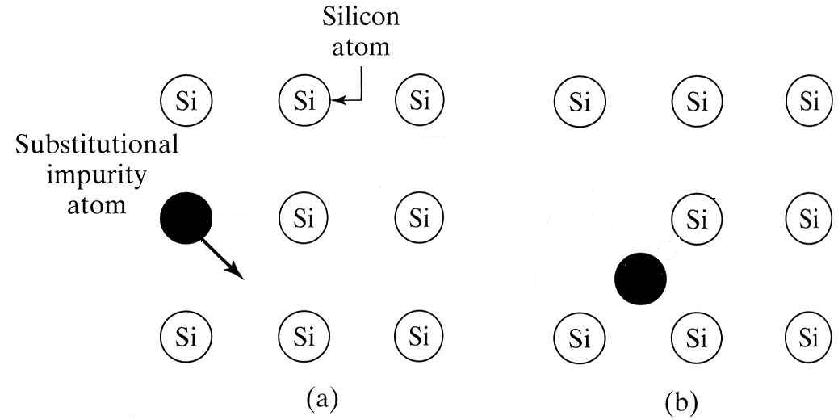
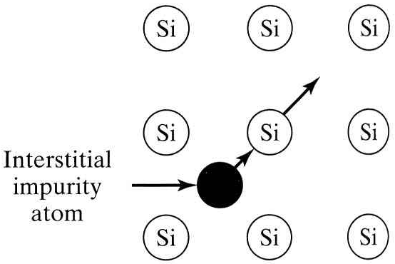
Diffusion mechanism (contd.)
3. Interstitial-substitutional Diffusion
3.a) Diffusion by dissociative mechanism
(Cu, Ni)
3.b) Diffusion by kick-out mechanism
(Gold and Platinum)
IC Technology Ms. Neha Singh
Notes:
Interstitial- substitutional diffusion:
In this type of diffusion mechanism, the impurity atoms occupy interstitial as well as substitutional lattice sites. However, they move at significant rate when present in interstitial sites (by interstitial diffusion). This can be done in either of the following ways:
By dissociative mechanism: The dissociative mechanism by which a substitutional impurity becomes an interstitial impurity by creating vacancy is the controlling factor of the process. So, for Interstitial- substitutional diffusion, the effective diffusivity is a function of dissociative rate, impurity concentration and crystal quality. Cu and Ni diffuse through this mechanism.
By kick-out mechanism: here a rapidly moving interstitial diffuser displaces an atom in the substitutional site. The kicked out atom forms a self-interstitial. Gold and Platinum diffuse through this mechanism.

Slide 9
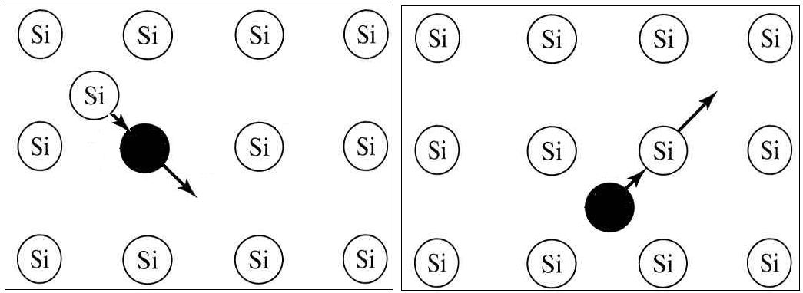
Diffusion mechanism (contd.)
4. Interstitialcy Diffusion (B and P)
5. Interchange Diffusion
6. Grain Boundary Diffusion
7. Combination effects
IC Technology Ms. Neha Singh
Notes:
Intertialcy diffusion:
It is the modified version of substitutional diffusion. The self interstitial knocks out the substitutional impurity atom to move to interstitial site. These impurities now diffuse to adjacent substitutional sites and create new self interstitials. Thus the interstitial position of the impurity atom is a transition state purely. All substitutional diffusers move, in part, by this mechanism. Boron and Phosphorous diffuse by this mechanism.
Interchange Diffusion: when an impurity and the host atom interchange their position. The probability of occurance of interchange diffusion is very low.
Grain boundary diffusion: this is diffusion along the dislocations and grain boundaries. Fast diffusion along dislocations.
Combination effect: combination of these mechanisms result in diffusion.

Slide 10

Fick’s First Law of Diffusion
Based on analogy between material transfer in a solution and heat transfer by conduction.
J=rate of transfer of solute per unit area or diffusion flux
C=concentration of solute (function of x and t only)
x=coordinate axis in the direction of solute flow
t=diffusion time
D=diffusivity (Diffusion constant)
Statement: The local rate of transfer of solute per unit area per unit time is proportional to the concentration gradient of the solute and defines the proportionality constant as diffusivity of the solute. The negative sign shows the flow towards lower concentration of solute.
IC Technology Ms. Neha Singh
Notes:
For complete derivation, refer class notes.

Slide 11
Limitation of first law
Though it describes diffusion process accurately.
But, has no convenient measure of current density of the impurity.
Thus, second law developed to describe the concept with more readily measurable quantities.
IC Technology Ms. Neha Singh

Slide 12
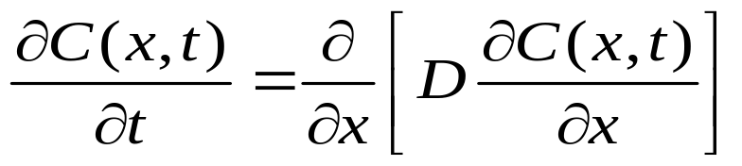
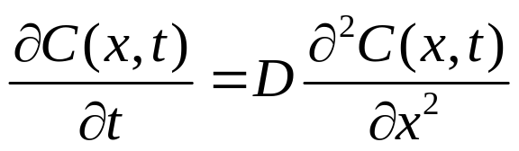
Fick’s second Law of Diffusion
Law of conservation of matter: change in solute concentration per unit time= local decrease in diffusion flux in the absence of source or sink.
Combining with Fick’s first law,
At low concentration of solute, diffusivity at a particular temperature can be considered a constant
IC Technology Ms. Neha Singh

